Slide 1
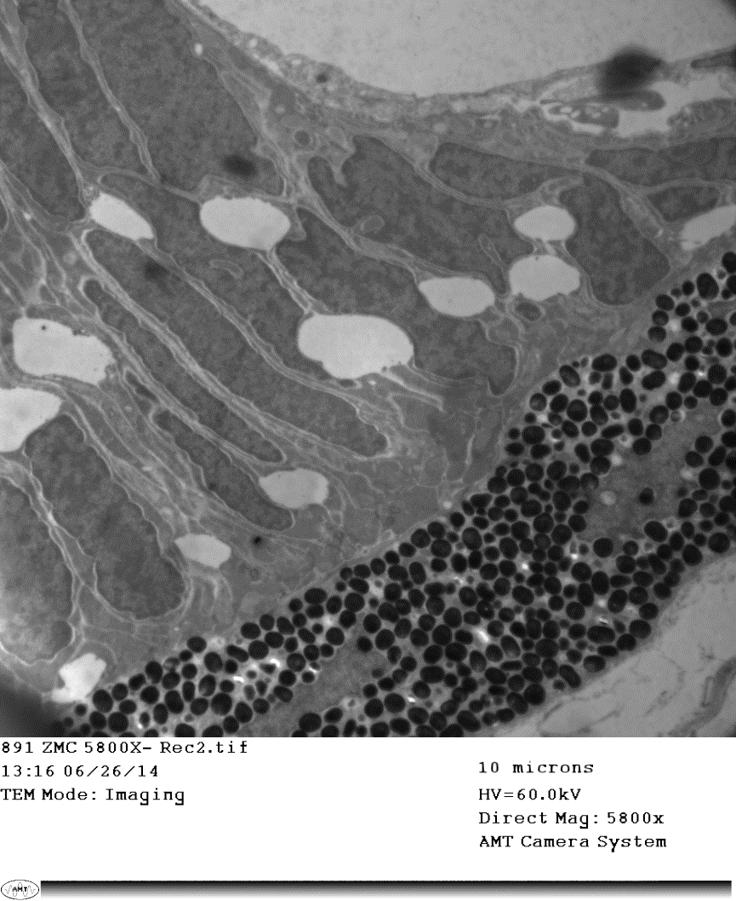
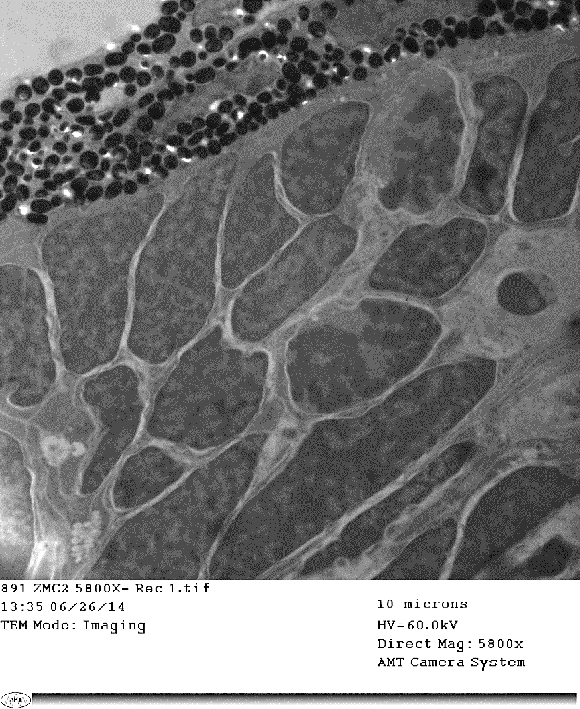
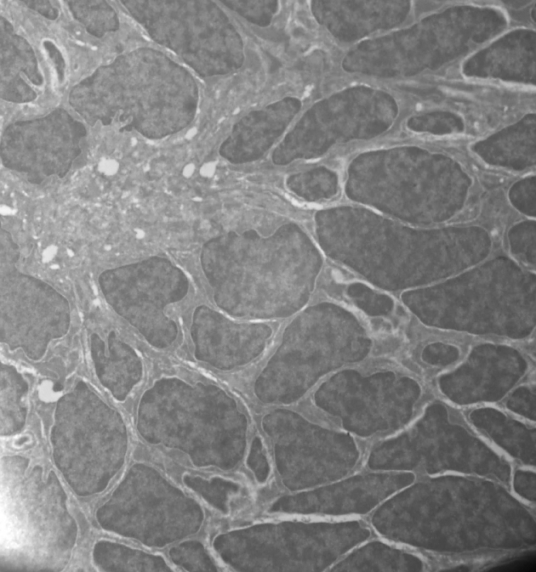
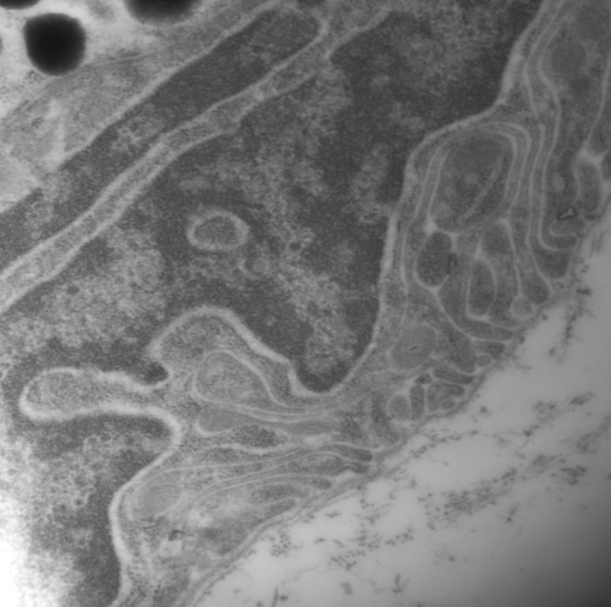
Figure 3
A
B
RPE
RPE
*
Mitosis
*
CMZ-Peripheral
CMZ-Middle
C
D
P
Nu
Nu
CMZ-Central
Non-pigmented
Ciliary epithelium (CE)
E
F
P
CMZ-P
Nu
Nu
CE

